Slide 1
Commute with Confidence: A Special Edition Brown Bag Webinar
Sponsored by: Colorado Valley Transit, Connect Transit, Conroe Connection, Fort Bend County Transit, Island Transit, Harris County Transit, Houston BCycle, Houston – Galveston Area Council, Metropolitan Transit Authority of Harris County, The Woodlands Township
May 21, 2020
Notes:
Thanks, Chuck.
My name is Jamila Owens. I am Manager of the Travel Demand Management Program housed in the transportation department at the Houston Galveston Area Council. Our transportation department functions as the MPO for our region.
We are also the newest team in transportation, formed in 2019.

Slide 2
Housekeeping
for Question and Answer, please type your questions in the Q&A section at the bottom of your screen.
This webinar is being recorded and will be placed online.

Slide 3
Agenda
Welcome and Introduction of Speakers/ Panelists
Deborah Mayfield, H-GAC
Commuting and the Return to Work: National Best Practices
David Straus, Association for Commuter Transportation
Local Transportation during COVID
Thomas Gray, H-GAC
Panelists Discussion
Thomas Gray, H-GAC
Q&A
Deborah Mayfield, H-GAC
Closing

Slide 4
Commuting and the Return to Work: National Best Practices
Presentation from David Straus

Slide 5
Local Transportation and COVID-19
Presentation by Thomas Gray

Slide 6
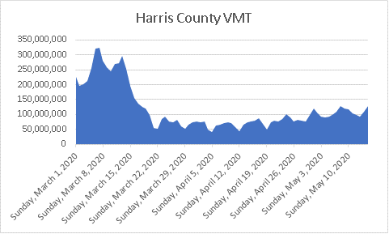
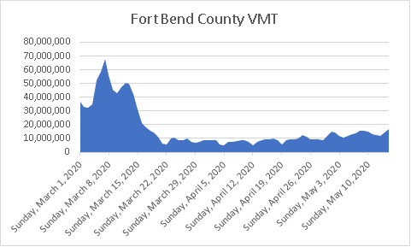
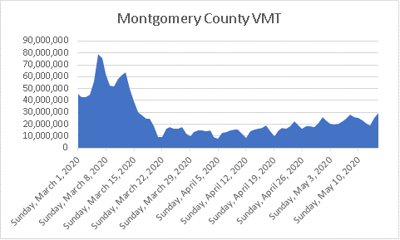
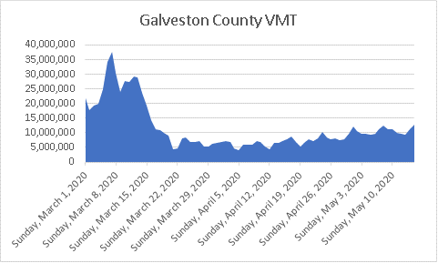
Significant Reduction in Regional Travel
Source:H-GAC Travel Demand Analysis

Slide 7
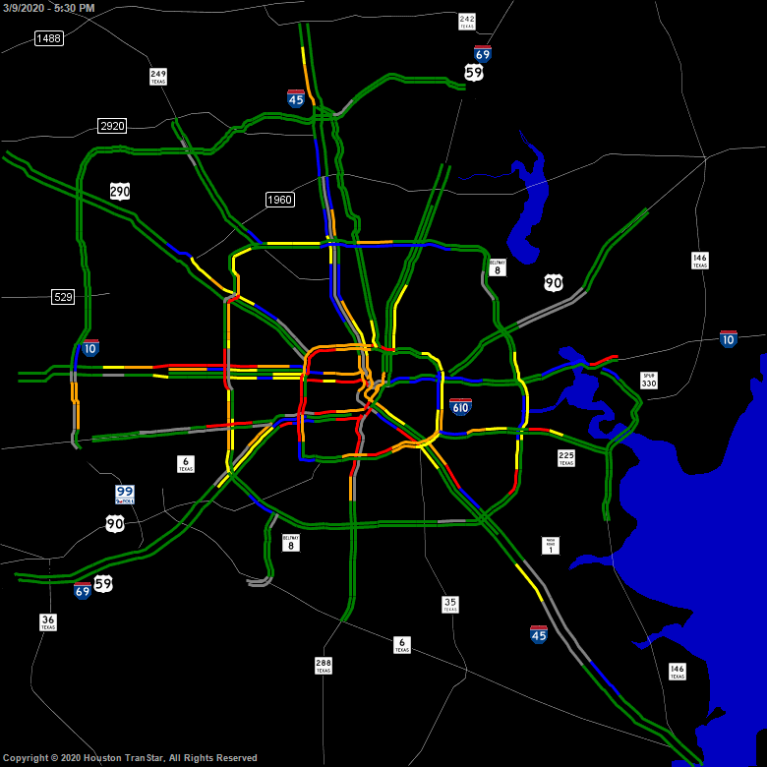
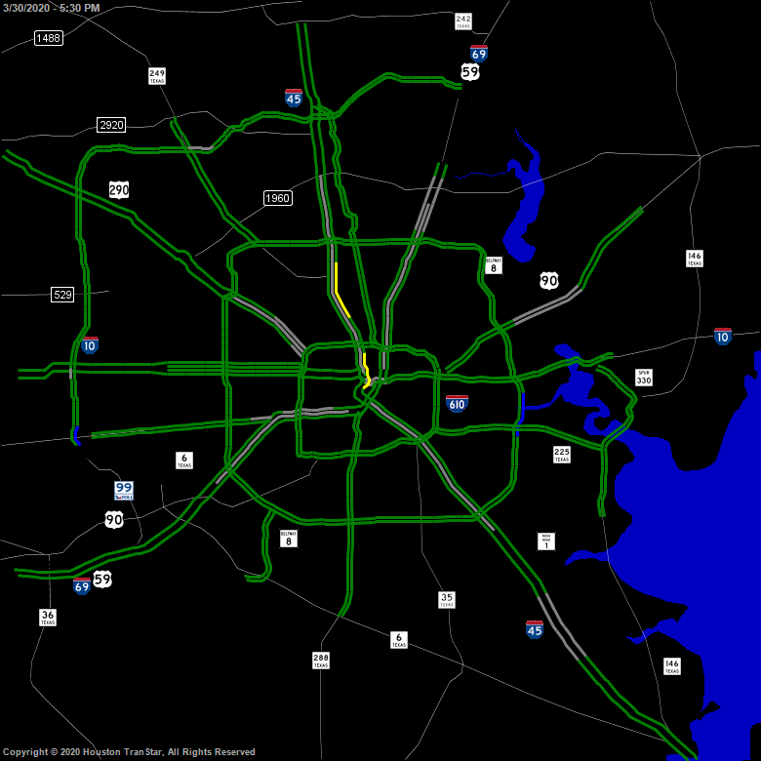
Significant Reduction in Regional Travel
Monday, March 9, 2020; 5:30 pm
Monday, March 30, 2020; 5:30 pm
Source: Houston Transtar

Slide 8
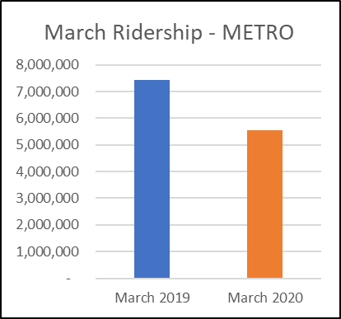
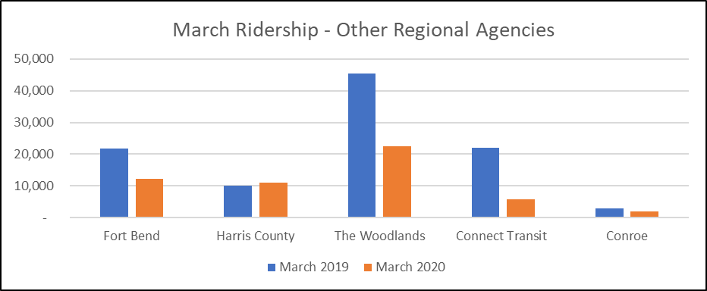
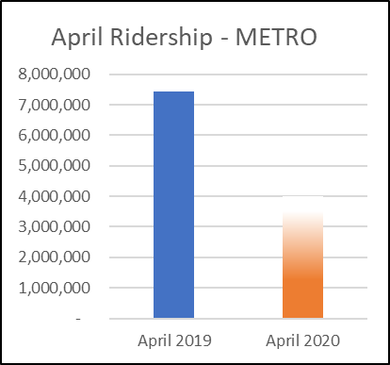
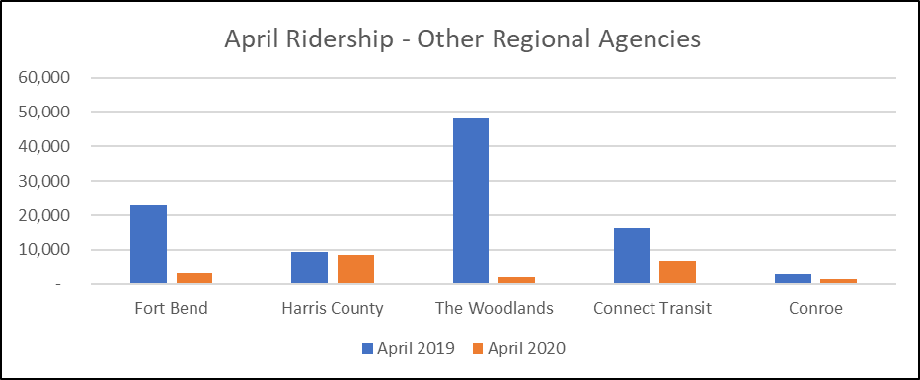
Significant Reduction in Transit Use
?
Source: Regional Transit Providers

Slide 9
How did regional transit agencies respond? Changes to Service
Service reductions: routes suspended, frequencies and hours of service reduced
Primarily to match decrease in ridership
Also due to labor shortages and other factors
Service additions: new routes, more frequencies
New routes and runs primarily aimed towards medical facilities/workers
Additional runs on busier routes to ensure social distancing
Partnerships with social services/nonprofits

Slide 10
How did regional transit agencies respond? Mitigation Measures
Ensure social distancing on buses and trains
Taped off seats to provide 6’ passenger separation
Enforced capacity restrictions on vehicles
Reduce interaction between driver and passenger
Fare collection suspended
Boarding by rear doors only
Provide PPE to drivers (masks, gloves)
Enhanced cleaning of buses and trains
More frequent and deeper cleanings/disinfections

Slide 11
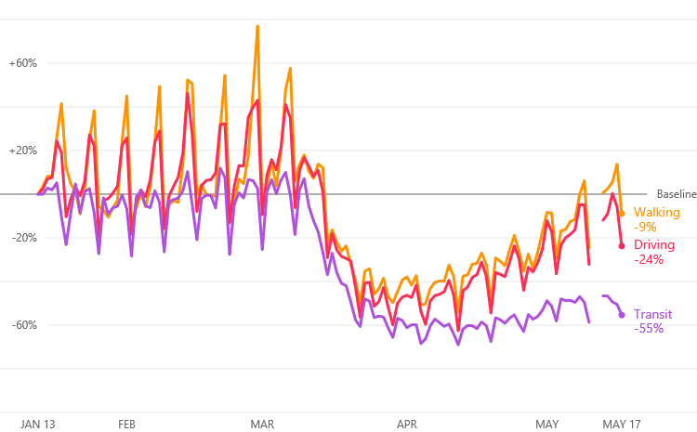
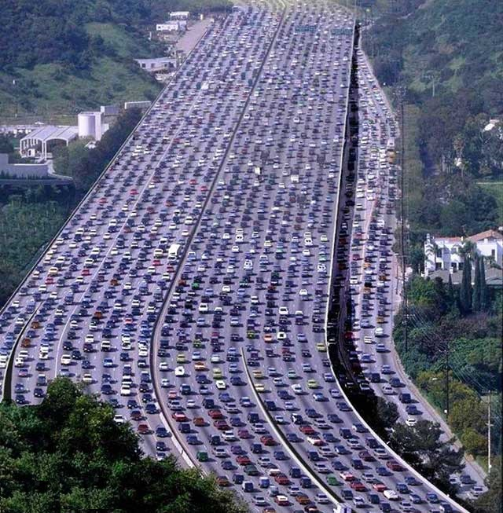
What happens as the region reopens?
Change in routing requests for Houston region Source: Apple
According to a survey by Capgemini Research, 51% of Americans say they’re less likely to use public transportation in the future.
Source: Detroit Free Press, 5/2/20

Slide 12
COVID-19, Transportation, and the Return to Work
Panel Discussion

Slide 13
Panelists
Claudia Wicks, Colorado Valley Transit
Ted Ross, Connect Transit
De'andre Guin, Conroe Connection
Melanie Beaman, Fort Bend Transit
Robert Andres, Harris County Transit
Beth Martin, Houston BCycle
Nathan Nevelow, Island Transit
Karen Marshall, METRO
David McMaster, METRO STAR
Sarah Coulter, The Woodlands Township
Moderator:
Thomas Gray, Houston-Galveston Area Council
Special Guest:
David Straus, Association for Commuter Transportation

Slide 14
Q & A

Slide 15
Additional Resources
Commute with Confidence Website and Guide
METRO Fact Sheet Bus and Rail
METRO Fact Sheet Vanpool

Slide 16
Thank You

Slide 17
www.yourcommutesolution.org
commutesolutions@h-gac.com

